Slide 1
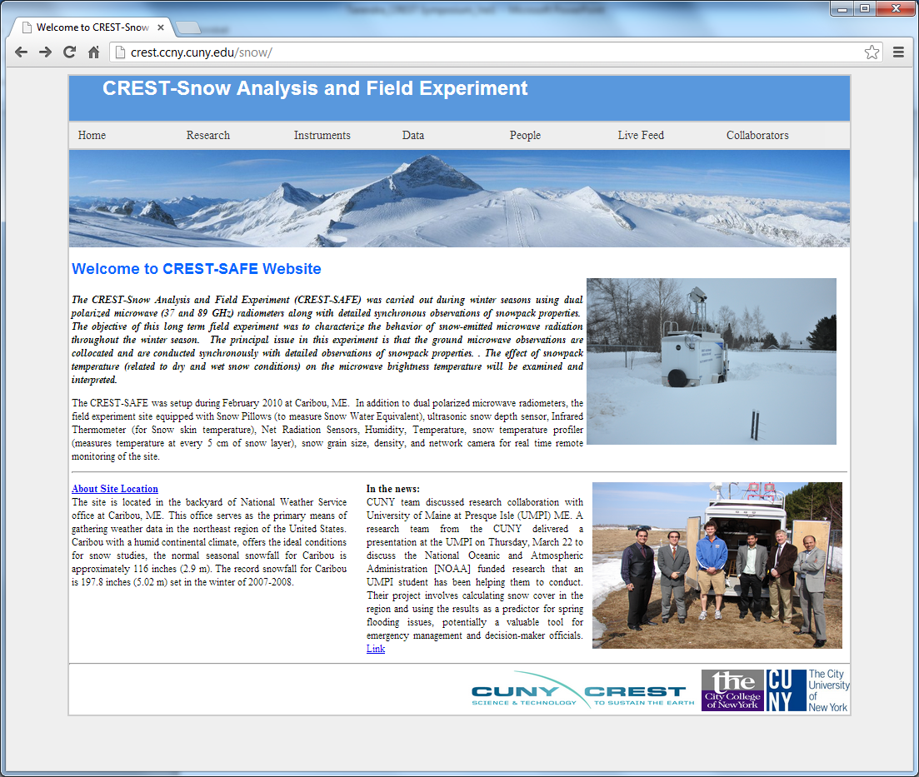
Tarendra Lakhankar, Jonathan Muñoz, Peter Romanov, Reza Khanbilvardi, Bill Rossow, Nir Krakauer , Al Powell, Jose Infante

Slide 2
Overview
Introduction
Study Area and Instrumentations
Research Objectives
Current Results and Analysis
  Microwave Emission Modeling
  Observations and Validations
Planned Instrumentations
Future Activities

Slide 3
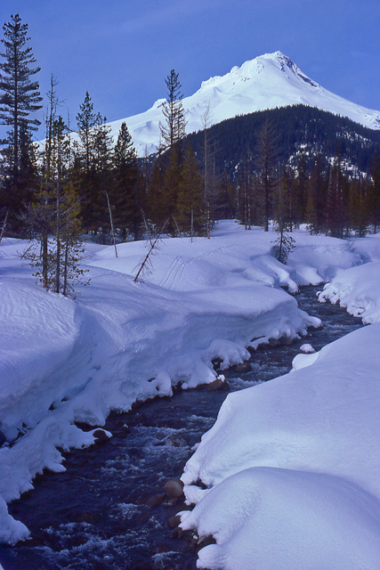
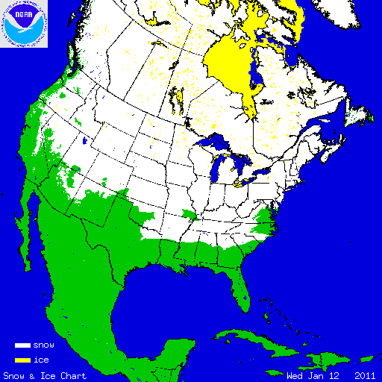
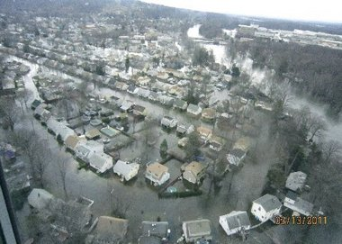
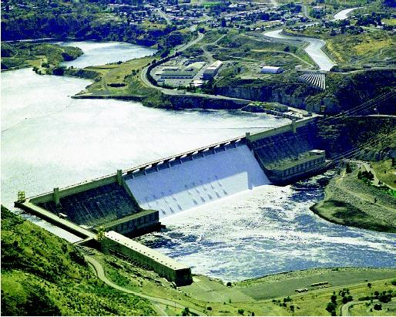
Introduction
Snow is an important factor for:
    Transportation
    Hydro-power generation
    Agriculture
    Wildlife
    Recreation
Seasonal Reservoir
NOAA needs information on snow to:
    Predict weather
    Monitor climate change
    Make hydrological forecasts
    Issue flood warnings
March 13, 2011
NOAA IMS Product
Man-made Reservoir

Slide 4
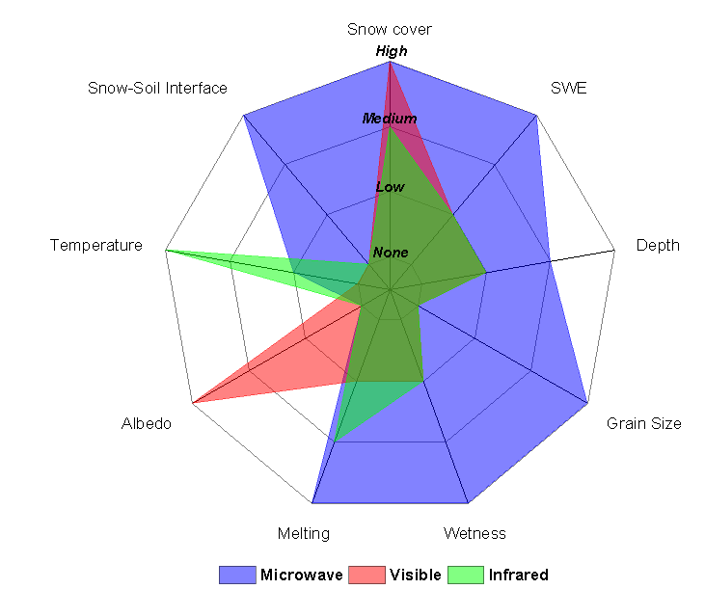
Microwave: The way to look inside the snow pack
What Information on Snow Is Needed ?
Upwelling microwave radiation is emitted by the sub-snow surface and altered by the snow pack.
Therefore it carries information on the physical properties of the snow pack.
Spectral range 10-100 GHz is most efficient for snow remote sensing
Sensor responses to snowpack properties

Slide 5
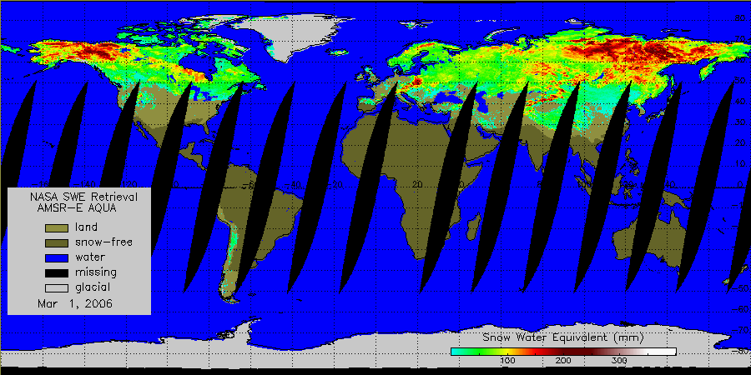
Microwave snow products
AMSR-E Aqua
Snow water equivalent
Daily, 25 km resolution
Snow depth and SWE have been derived since mid-1970s
Microwave snow algorithms
  - Assume fixed snow pack properties (e.g. grain size)
  - Use simplified models of Microwave Radiative transfer in snow pack
As a result:
  Retrieval errors are large (about 100% and more)

Slide 6
Study Area and Objective

Slide 7
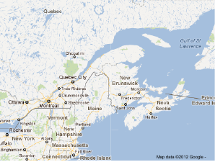
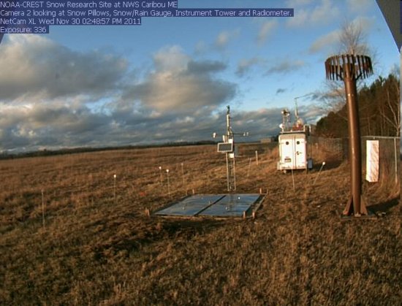
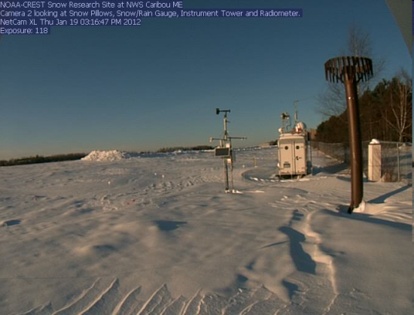
CREST-SAFE Field Research Station at Caribou, ME
Established in 2010 in Caribou, ME
  Located on the premises of NWS Regional Forecast Office at Caribou Regional Airport
Climate
  Humid continental climate.
  Normal seasonal snowfall for Caribou is approximately 116 inches (2.9 m).
  Record snowfall is 197.8 inches (5.02 m) set in the winter of 2007-2008.

Slide 8
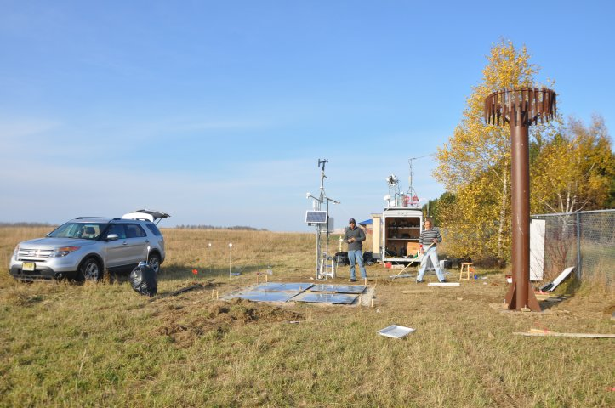
CREST-SAFE: Instruments
Incoming solar and reflected radiation
Antenna
Wind speed and direction
Microwave radiometers, 37 and 89 GHz
Snow depth ultrasonic sensor
Web camera 1
Air temperature and humidity sensor
Snow pack temperature profiler
Infrared surface temperature sensor
Soil moisture sensors
Snow/Rain precipitation gauge
Snow pillow (SWE)
All instruments operate automatically. Data are transmitted to CREST Center for analysis in real time

Slide 9
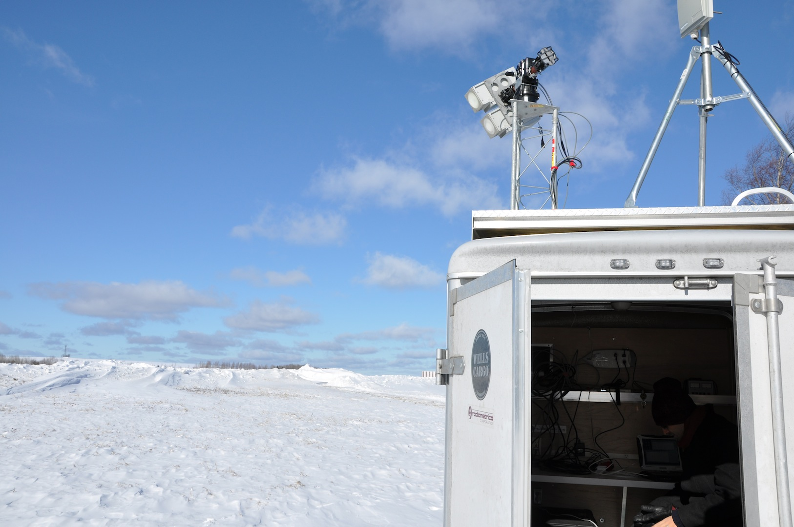
Microwave Radiometers
CREST Radiometers
Frequency, GHz | Polarization
37 | V, H
89 | V,H
CREST radiometers provide observations at the same frequencies as Special Sensor Microwave Imager (SSMI) and Advanced Microwave Scanning Radiometer for EOS (AMSR-E) .
Special Sensor Microwave Imager (SSMI)
Frequency (GHz) | Polarization | Spatial Resolution (Km)
19 | V, H | 25
22 | V | 25
37 | V, H | 25
87 | V, H | 12.5
Advanced Microwave Scanning Radiometer (AMSR-E)
Frequency (GHz) | Polarization | Spatial Resolution (Km)
6.92 | V.H | 59
10.95 | V.H | 40
18.7 | V.H | 21.5
23.8 | V.H | 25
36.7 | V.H | 11
89 | V.H | 5
Notes:
Hello Everyone.
In this presentation, I will talk about our current Snow field experiment, instrumentations and show you some preliminary results. Here I would like to thank all my colleagues at NOAA-CREST Center Dr. Temimi, Marco Tedesco, and Bill Rossow for their support and advices.
The picture on the first page was taken on site exactly one year during installation. Unfortunately, we didn’t receive any snow in that winter season.

Slide 10
Objectives
Study seasonal changes in the snow pack (density, grain size, etc.)
Study snow microwave emission and its relation to snow properties
Test and improve models
- Simulating snow pack physical properties
- Relating snow pack properties and snow emissivity
Develop advanced satellite-based snow retrieval techniques
Test new instrumentation for snow research

Slide 11
CREST-SAFE
Observations and Analysis

Slide 12
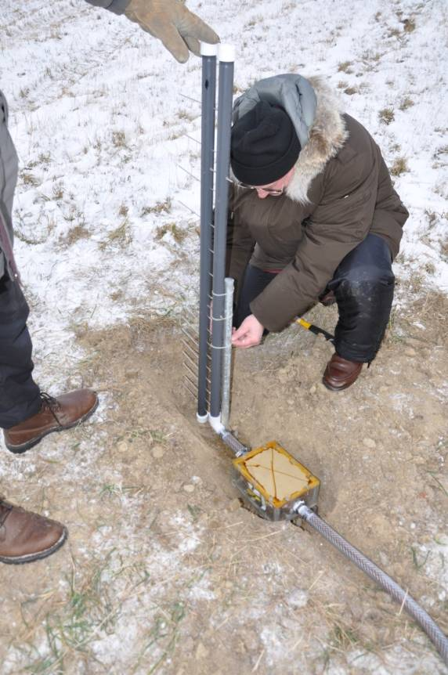
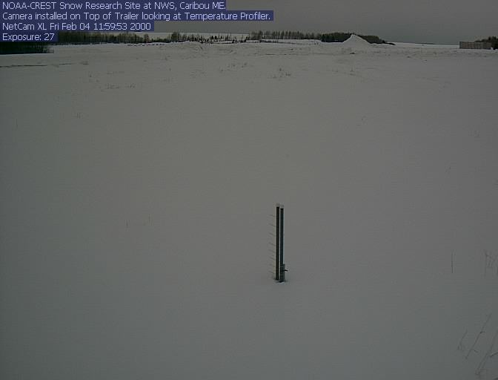
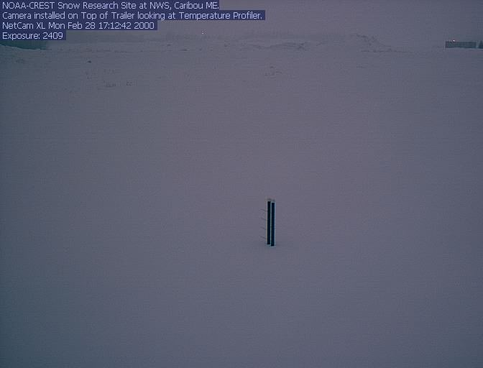
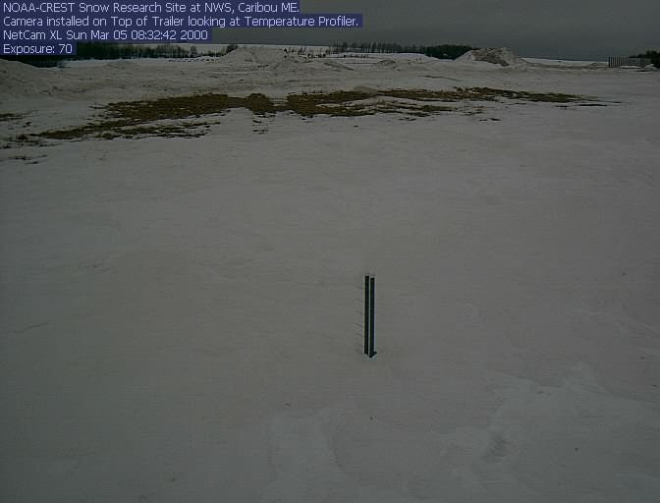
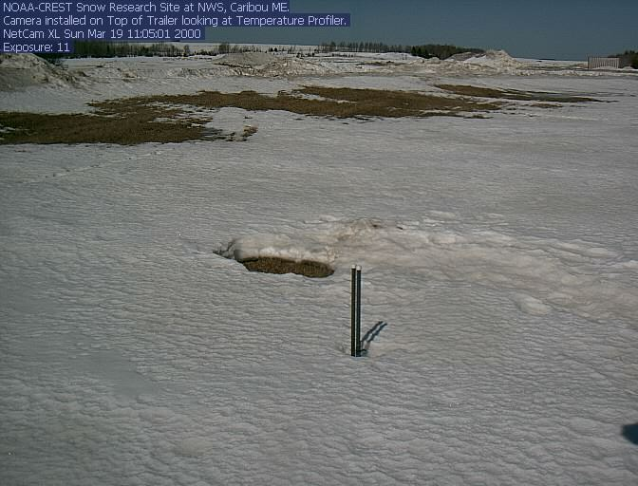
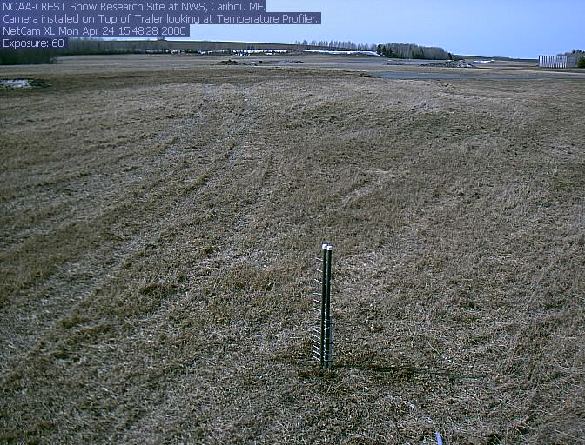
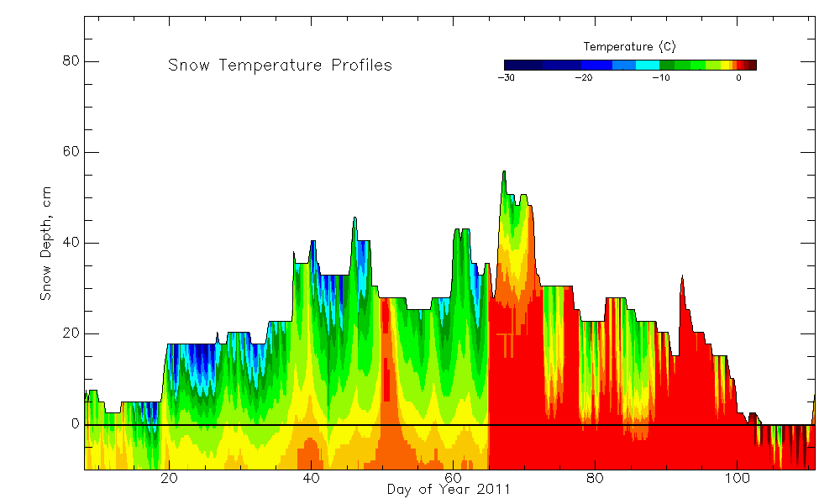
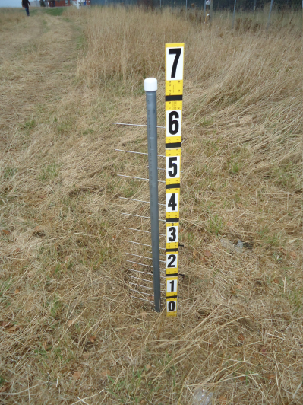
CREST-SAFE: Observations
Snow pack and soil temperature profiler
- Measures temperature at 16 levels
- Down to 10 cm in soil
- Up to 1.0 m in the snow pack
Red color indicates 0⁰C temperature
Observed snow depth and snow temperature profiles in January to March 2011

Slide 13
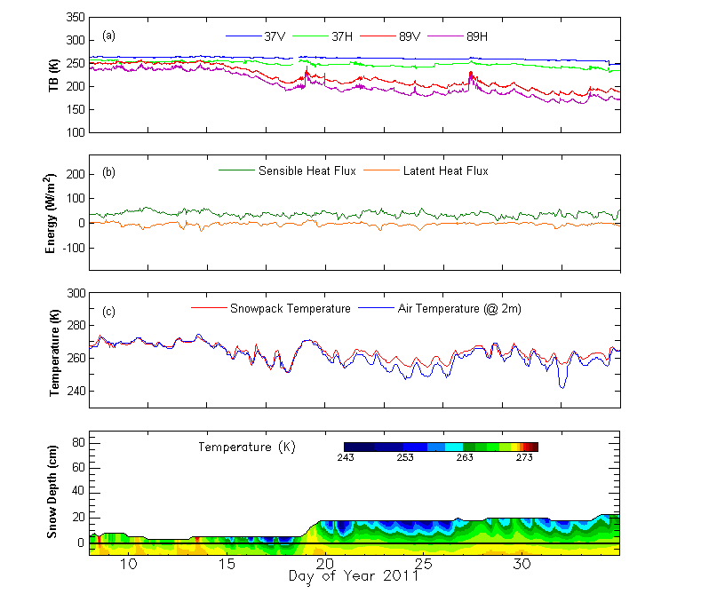
Early Winter Measurements
Snow accumulates during snowfall events due to below freezing temperature without snow melts.
The diurnal variation of brightness temperature during this period was expected to be smaller due to slow snow metamorphism compared to mid and late winter period.
Lakhankar, T., Muñoz, J., Romanov, P., Powell, A. M., Krakauer, N. Y., Rossow, W. B., and R. M. Khanbilvardi (2013) CREST-Snow Field Experiment: analysis of snowpack properties using multi-frequency microwave remote sensing data, Hydrology Earth System Science (HESS), 17, 783-793, doi:10.5194/hess-17-783-2013.

Slide 14
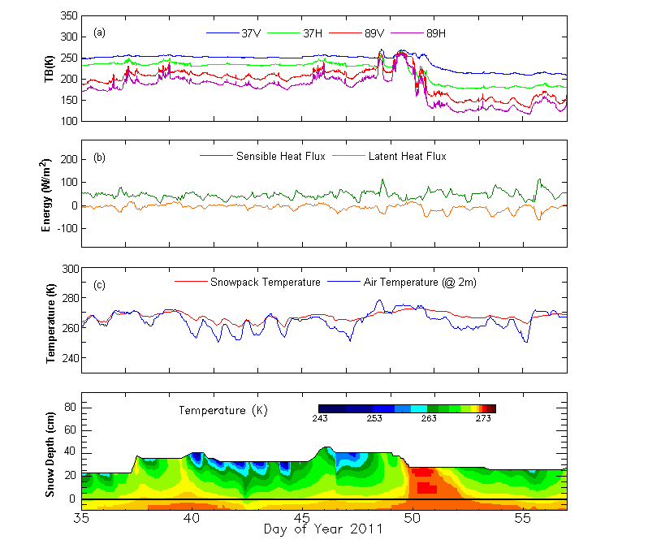
Mid Winter Measurements
Similar snow depth and snow pack temperatures, but different microwave brightness temperatures
Other snow pack properties (snow density, grain size, ice layers) are different
Fresh snow
Snow melt
Refrozen snow

Slide 15
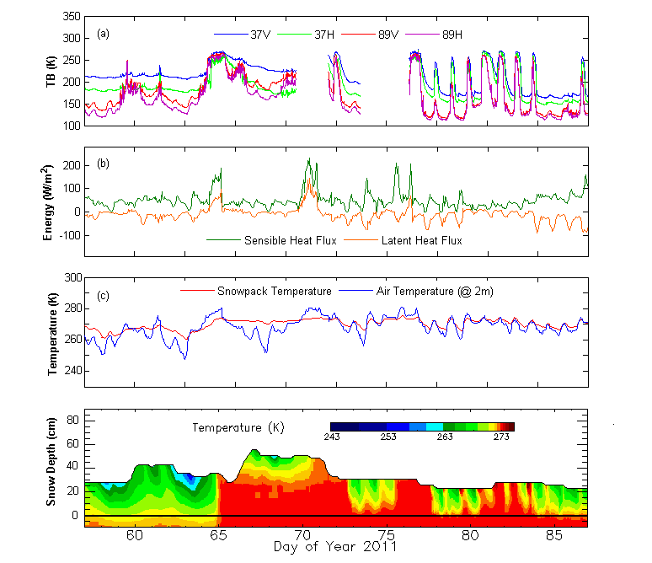
Late Winter-Early Spring Measurements
Due warm day and cold night, we observed cycle of melting and refreezing, that causes large variation in brightness temperature during this period.
During melting and refreezing, the trends in 37 and 89 GHz of brightness temperatures were consistent with snowpack temperature

Slide 16
Modeling Comparison and validation

Slide 17
Snow Models
The HUT snow emission model is a semi-empirical model based on the radiative transfer theory. The model describes the snowpack as a homogenous layer, using effective values for parameters influencing scatter such as snow depth, density and grain size
Units | Variable
°C | Snow temperature
m | Layer thickness
g/cm3 | Snow density
mm | Snow grain diameter
% | Snow moisture, volumetric
ppm | Snow salinity
The Snow Thermal Model (SNTHERM) is a 1-dimensional model that analyzes the snowpack properties given the climatological conditions of a particular area
Unit | Variable | Source
°K | Air Temperature | NOHRSC, NCDC, NLDAS
m/s | Wind Speed | NCDC
m/s | Precipitation Water Eq. | NOHRSC, NCDC, NLDAS
1=Rain, 2=Snow | Precipitation Type | NOHRSC, NCDC
m | Precipitation Diameter | NCDC
W/m2 | Incoming Solar | NOHRSC, NCDC, NLDAS
Fraction | Reflected solar | NOHRSC, NCDC, NLDAS
W/m2 | Down welling Long Wave | NOHRSC, NCDC, NLDAS
% | Low Cloud Cover | NOHRSC, NLDAS
 | Cloud Type | NOHRSC, NCDC, NLDAS
 | Mid Cloud Cover | NOHRSC, NCDC, NLDAS
 | High Cloud Cover | NOHRSC, NCDC, NLDAS

Slide 18
Modeling Approach
NWSO
(Met. Observations)
Observed Data
(Snow Pit)
Data
Acquisition
Snow temperature
Snow Grain size
Snow Density
Liquid Water Content
Snow temperature
Snow Grain size
Snow Density
Liquid Water Content
SNTHERM
Model
HUT Snow Model
(or Improved CRTM)
Modeling
Brightness Temperature #1
Brightness Temperature #2
Statistical analysis & Errors Identification
Analysis
Main Steps
Secondary Steps
Early
Mid
Late

Slide 19
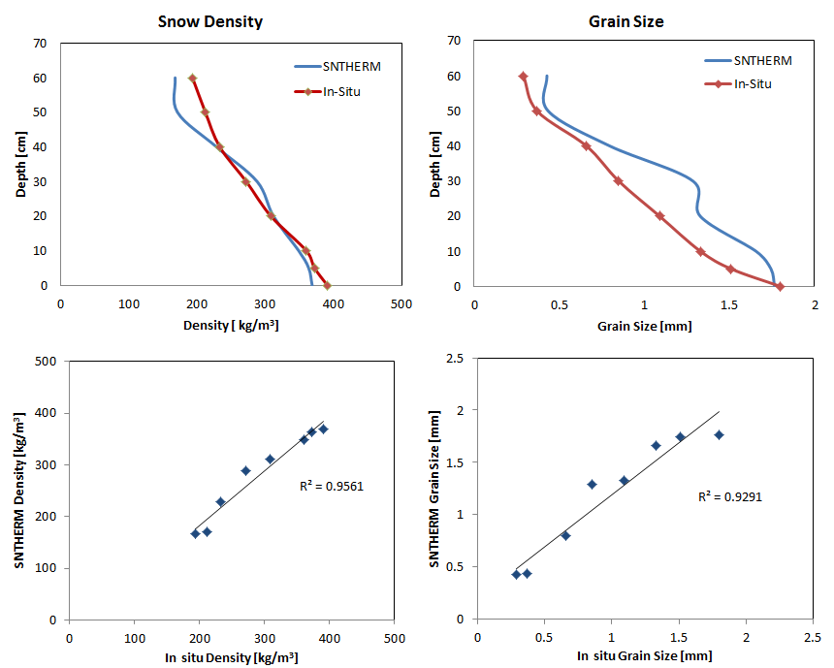
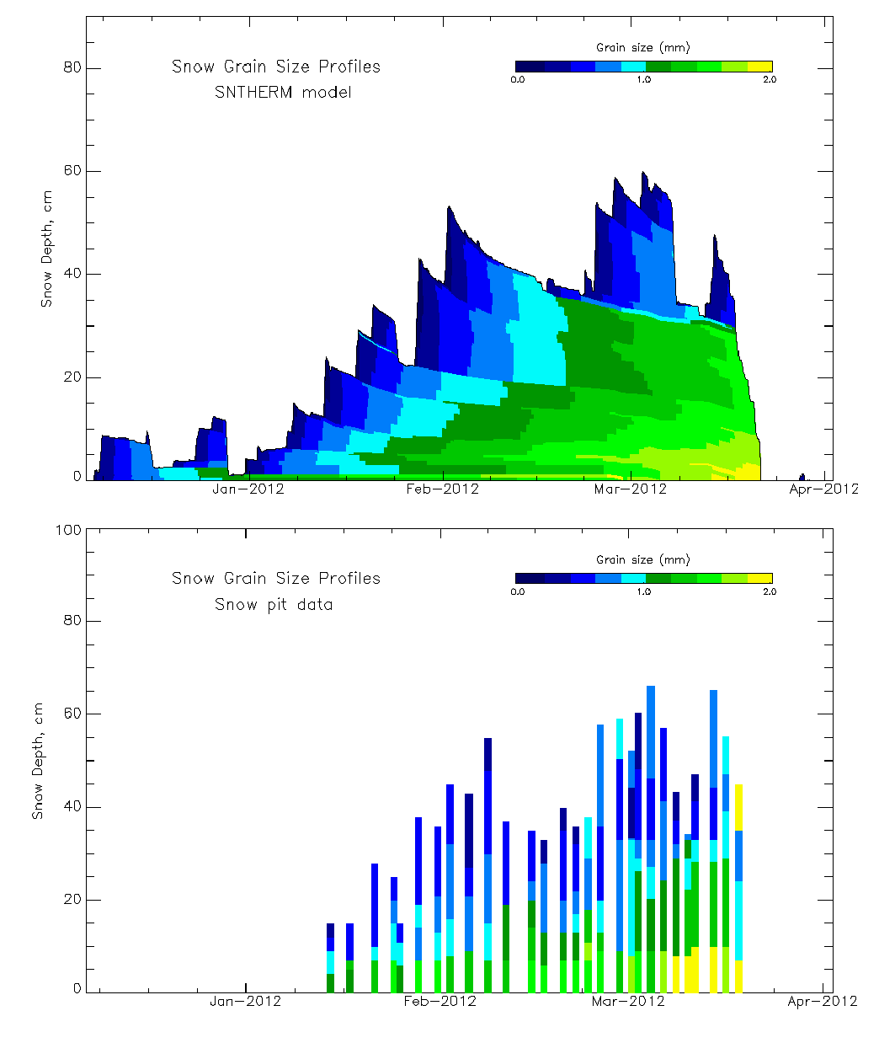
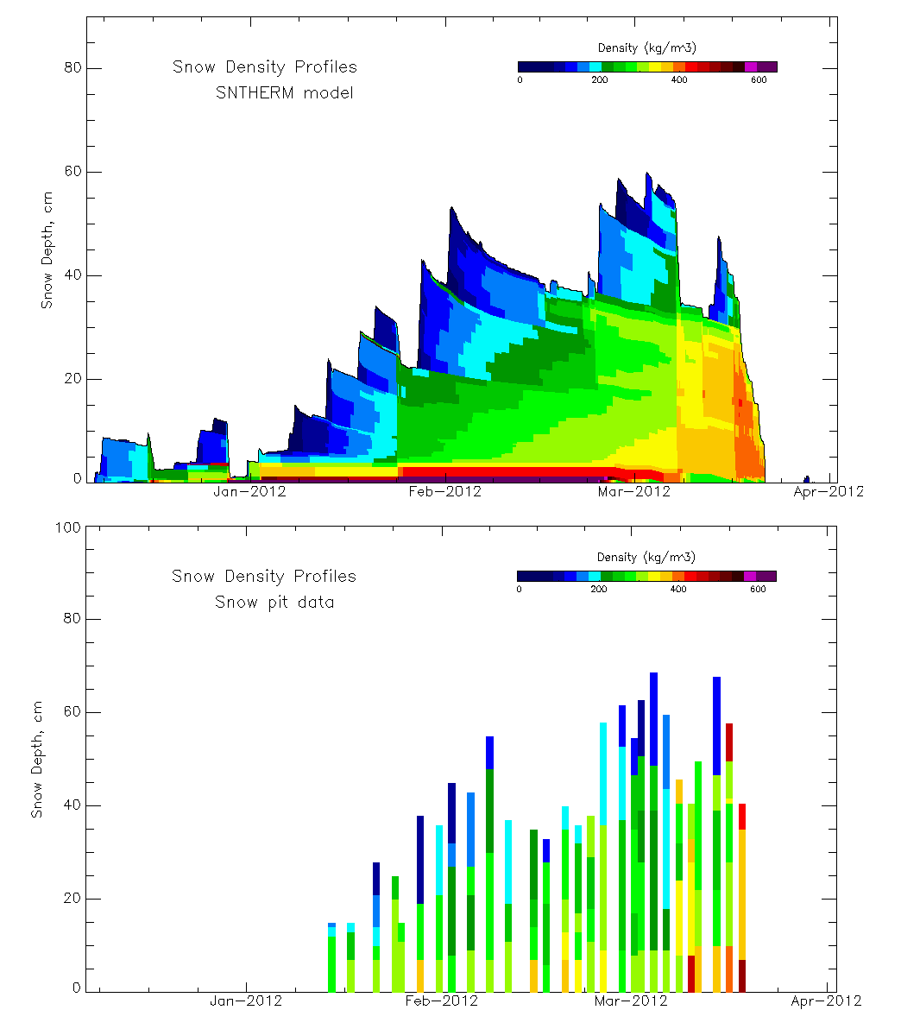
Snow Density and Grain Size
Comparison of observed (snow pit) grain size and density with modeled data at varying snow depth.

Slide 20
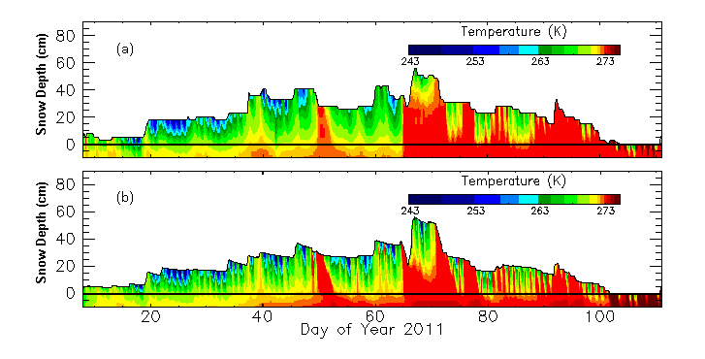
Modeling Studies
SNTHERM model
Input: Meteorological parameters
Output: Physical properties of snow
Output of this model can be used to predict snow microwave emission
Sensor Level (cm) | Correlation Coefficient ( R ) | Mean Absolute Difference ⁰C
T(-10) | 0.813 | 0.695
T(-5) | 0.834 | 0.541
T(0) | 0.847 | 0.744
T(+2) | 0.850 | 1.091
T(+4) | 0.905 | 1.161
T(+6) | 0.910 | 2.050
T(+8) | 0.803 | 1.895
T(+10) | 0.759 | 3.383
T(+12) | 0.733 | 2.636
T(+15) | 0.507 | 2.335
T(+18) | 0.877 | 2.784
T(+21) | 0.881 | 3.595
Comparison of observed temperature with modeled temperature of snowpack at varying snow depth.

Slide 21
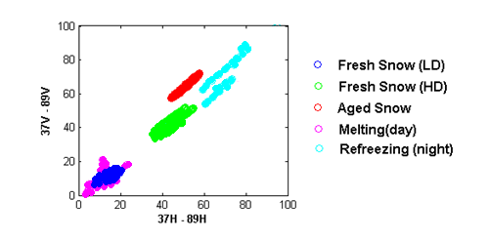
Microwave Response (Classification Analysis)
Identify different snow class based on microwave observations
Identify real contribution of different snowpack characteristic to the microwave emission (Grain Size, Wetness and Temperature).
Define the possible sources of error in the modeling.

Slide 22
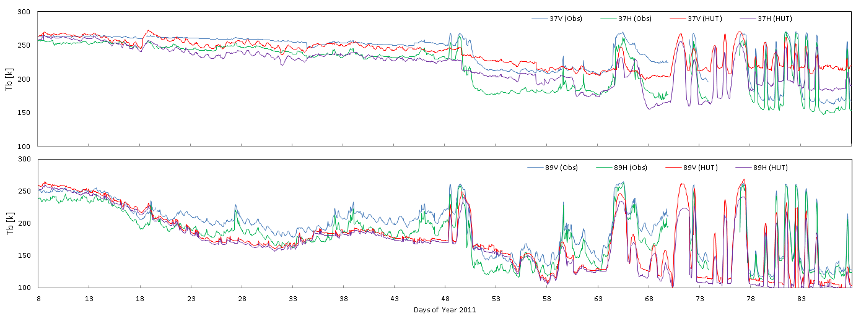
CREST-SAFE vs. HUT Model
The HUT model considers the snowpack as a homogenous layer, and uses effective values for parameters affecting the scatter of microwave radiation in the snowpack, including snow depth, density and grain size.
Simulation for winter 2011

Slide 23
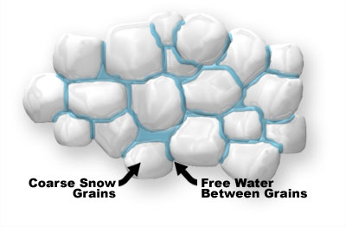
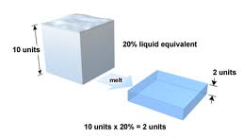
Snow Wetness and Snow Water Equivalent
Snow Water Equivalent
(Water yield from volume of snow)
Snow Wetness

Slide 24
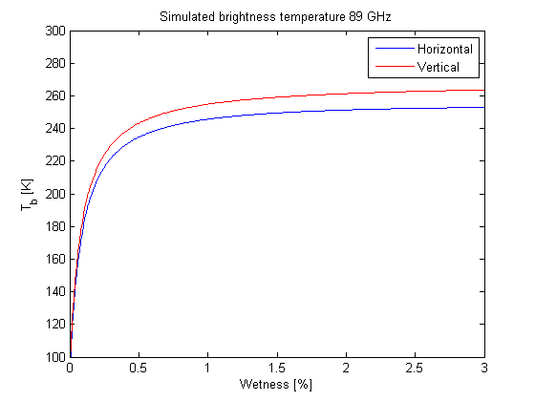
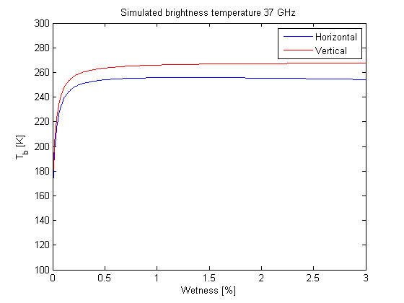
Snow Wetness
Microwave emission models are highly sensitive to the Snow Wetness.
Lack of existing methods, to measure snow wetness in a simple, cheaply and continuously way.
Actual microwave retrievals typically exhibit low accuracy and larger errors at the end of the winter season.
Sensitivity Analysis
Wet Snow
Dry Snow

Slide 25
Snowpack temperature and brightness temperature
The estimation of snow wetness is a difficult task even at ground level, so it is crucial to further investigate the contribution that remote sensing techniques can make in that regard, alone or coupled with a snow physical models.
CREST-SAFE vs. HUT Model
Correlation between SPT and Bt

Slide 26
Future Plans

Slide 27
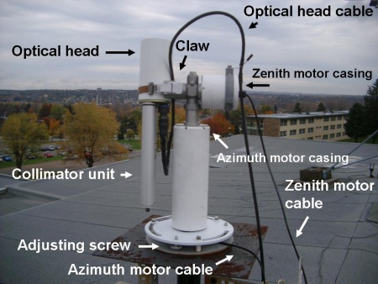
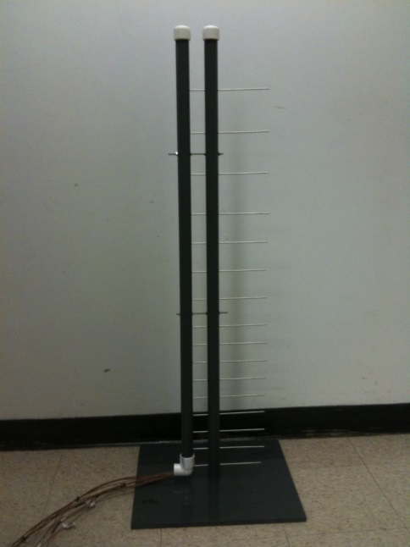
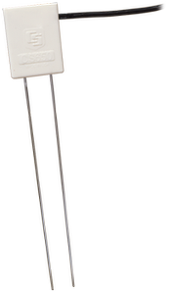
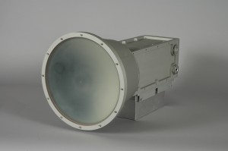
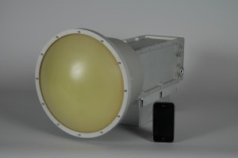
Future Plans - Instrumentations
Dual polarized 10.65 GHz and 19 GHz Microwave radiometers
CIMEL Sun-photometer
  A multichannel automated ground and sky-scanning radiometer manufactured by CIMEL Electronique, takes measurements of direct sun, sky-scattered and surface-reflected radiation at pre-determined (0.6 – 1.2 µm) wavelengths in the VIS/IR band.
Snow Wetness Profiler
    To measure snow wetness using proxy measurement of conductivity in snowpack. (larger snow grains are more conductive)
CS650 - Measures dielectric permittivity, and bulk electrical conductivity.
$270K is approved and will be funded through Defense University Research Instrumentation Program (DURIP) of The Department of Defense (DoD).

Slide 28
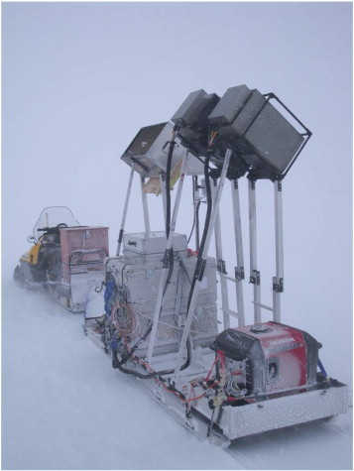
Future Plans - Activities
Data Logger
Mobile Temperature Profiler
Measurements with the surface-based radiometers on a sledge to characterize the spatial variability.

Slide 29
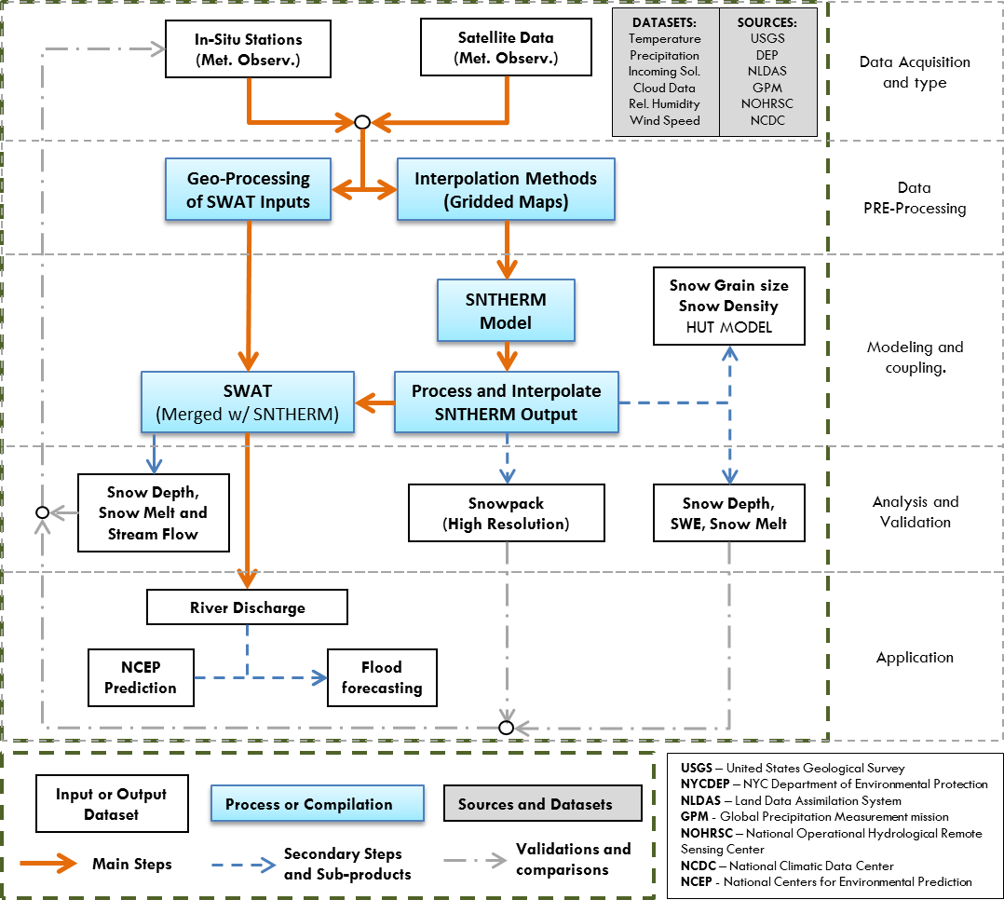
Applications – Watershed Modeling

Slide 30
Applications – Improvement of Snow Emission Model
NCDC
(Met. Observations)
Satellite Data
(Microwaves)
Satellite Data
(Visible/Infrared/MW)
Observed Data
(Snow Pit)
Data
Acquisition
Krigging
(Gridded Maps)
Brightness
Temperature
Snow Temperature
Grain Size
Snow Temperature
Grain Size
SNTHERM
Model
Snow temperature
Snow Grain size Snow Density
HUT Snow Model
(or Improved CRTM)
Snow Wetness
Snow Wetness Index
Modeling
Cross Validation with CREST-SAFE DATA
Gridded Snowpack
(Daily)
Main Steps
Application
Secondary Steps
Snowpack
(High Resolution)
Avalanche Risk Index
Future Work

Slide 31





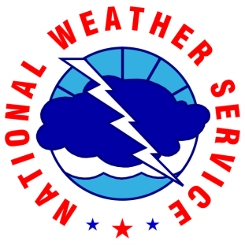
Acknowledgements
Center for Satellite Applications and Research (STAR)
Dr. Alfred M. Powell
NWS WFO Caribou ME
Dr. Peter Rahe
Dr. William Desjardins
Other staff members
City College of New York (CCNY)
Dr. Marouane Temimi
Eugene Leykin
University of Maine at Presque Isle
Philip Boody
Prof. David Putnam
Prof. Chunzeng Wang

Slide 32
